Slide 1
Tax Liability Payments and Tax Reports
Chapter 13 Section 3
Accounting II
Ms. Alltucker

Slide 2
Tax Liability and tax reports
What you will learn:
How to pay payroll tax liabilities
Which tax reports are prepared and filed.
Why it’s important:
Business owners must pay their payroll liabilities and file payroll tax reports promptly and accurately.

Slide 3
Paying the payroll tax liabilities
FICA and Federal Income Taxes
One payment is made for:
Social security and medicare taxes (both the employees’ and employers)
Employees’ federal income taxes
Payment is made at an authorized financial institution or a Federal Reserve bank
Most businesses this payment is made monthly—due by the 15th of every month
Large businesses pay every two weeks
Small businesses prepare and send the Federal Tax Deposit Coupon
Identifies the type of tax and the tax period
Also known as Form 8109

Slide 4
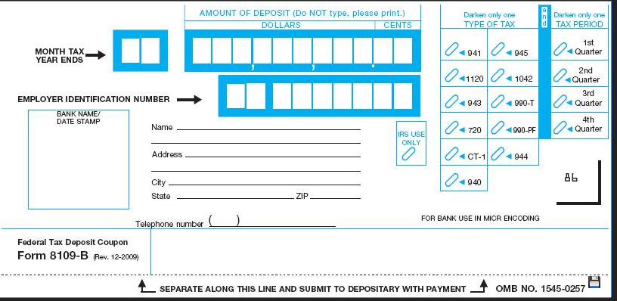
Form 8109
Oval 941 → FICA and Federal Income Tax
Also darken the oval with the corresponding quarter tax period

Slide 5
Business Transaction
After recording the June 30 payroll and the employer payroll taxes, Roadrunner pays its payroll tax liabilities of $908.76, which include employees’ federal income taxes of $393.18, social security taxes of $417.80 and Medicare taxes of $97.78 on July 15th.

Slide 6
Federal income taxes
JOURNAL ENTRY

Slide 7
State income taxes
Each state determines how and when the payments are made and what reports are filed.
Example: Roadrunner pays $348.13 to the state.

Slide 8
State income taxes
JOURNAL ENTRY

Slide 9
Federal unemployment taxes
Most businesses pay federal unemployment taxes quarterly
If a business has accumulated less that $100 in federal unemployment—only one annual payment
Federal tax Deposit Coupon (Form 8109) is prepared and sent with the check
940 oval and the respective quarter

Slide 10
Federal unemployment taxes
Oval 940 and the respective quarter

Slide 11
Federal unemployment taxes
JOURNAL ENTRY

Slide 12
State unemployment taxes
Generally paid on a quarterly basis
JOURNAL ENTRY

Slide 13
Other payroll liabilities
Employers pay the appropriate organizations for all voluntary deductions
Insurance premiums
US Savings bonds
Union dues
Insurance
Charitable Donations
JOURNAL ENTRY

Slide 14
Posting the payment of payroll liabilities
Refer to page 332 for a review of posting the payment of payroll liabilities
DON’T FORGET POST REFERENCE NUMBERS

Slide 15
Preparing payroll tax reports
Form | Name of Form | Filed
W-2 | Wage and Tax Statement | Annually
940 | Employer’s Annual Federal Unemployment (FUTA) Tax Return | Annually
941 | Employer’s Quarterly Federal Tax Return | Quarterly
W-3 | Transmittal of Wage and Tax Statements | Annually

Slide 16
Wage and tax statement
Form W-2
Summarizes an employee’s earnings and withholdings for the calendar year
Employees receive W-2 forms by January 31st
Assists employees in preparing personal taxes
1 copy goes to the IRS, two copies to the employee, 1 copy to the employer.
Some states want one submitted at the local level
Reports
Gross earnings
Federal income tax withheld
FICA taxes withheld
State and local income tax withheld

Slide 17
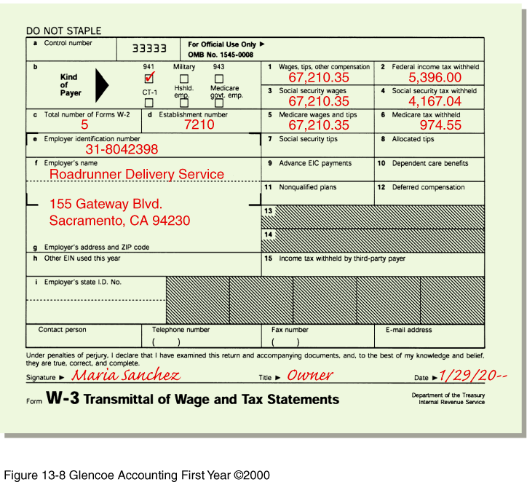
W-2

Slide 18
Form 940 and 941
Form 940
Report the employer’s unemployment (state and federal) taxes
Form 941
Employers quarterly federal tax return on which accumulated amounts of FICA and federal income tax withheld from employees’ earnings
Also includes the FICA taxes owed by the employer

Slide 19
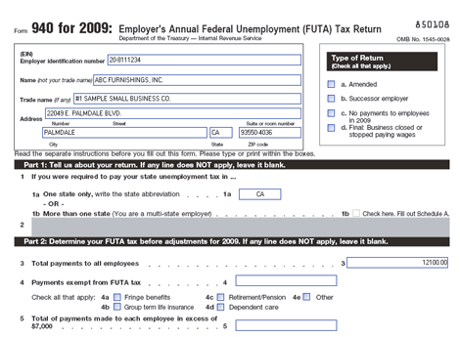
Form 940

Slide 20
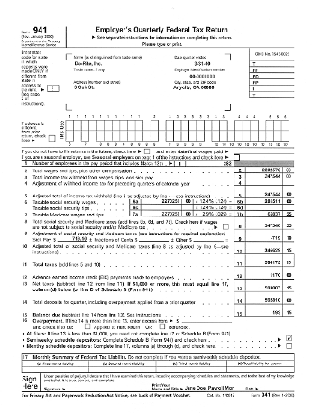
Form 941

Slide 21
Transmittal of wage and tax statements
W-3
Filed with the federal government
Summarizes the information contained on the employees’ Forms W-2
Due by February 28th
Employer also includes copy A of the employee’s W-2 to check individual income tax returns

Slide 22
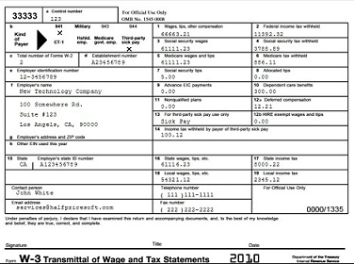
W-3

Slide 23
Thinking critically
What accounts are affected when a business pays the federal unemployment tax?
What information is included on a Form W-2?

